Slide 1
Write a program to construct a Bayesian network considering medical data. Use this model to demonstrate the diagnosis of heart patient using standard heart disease dataset.
ML Practical – 8 A

Slide 2
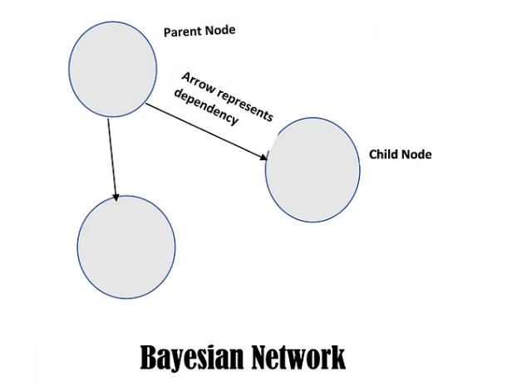
Basics of Bayesian Network

Slide 3
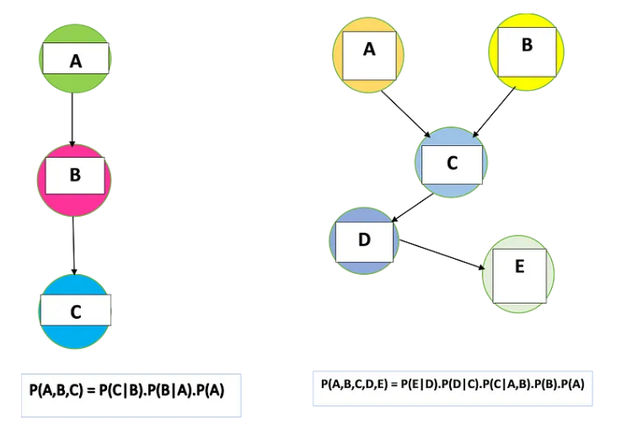

Slide 4
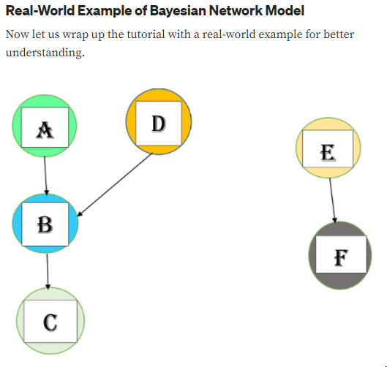
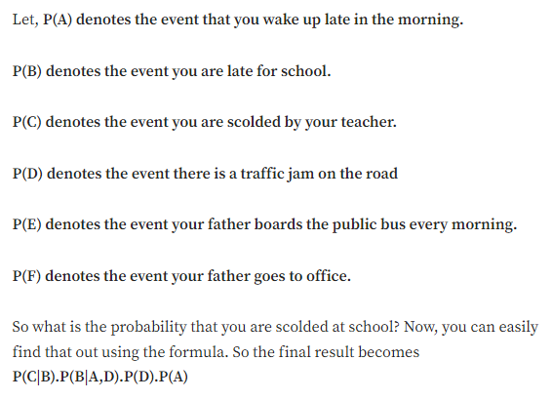

Slide 5
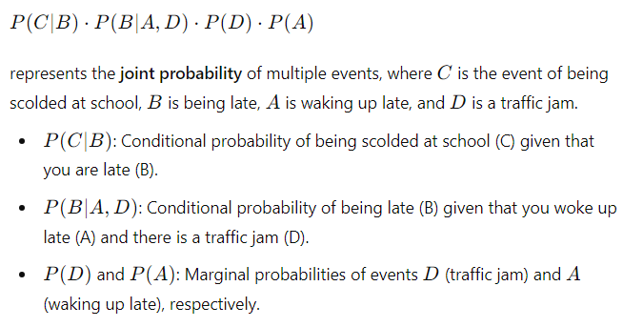


Slide 6

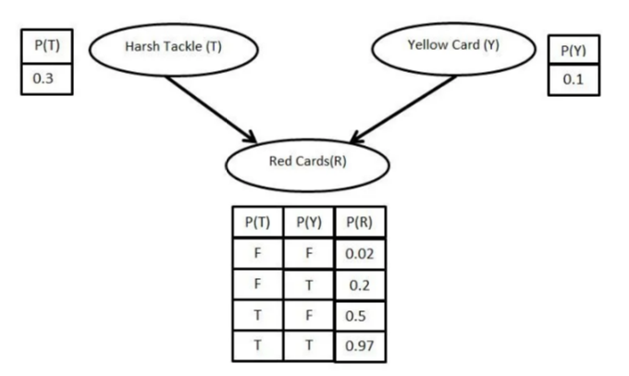
In a Bayesian network, conditional probabilities are defined in the model and can be calculated automatically based on the relationships between the variables.

Slide 7

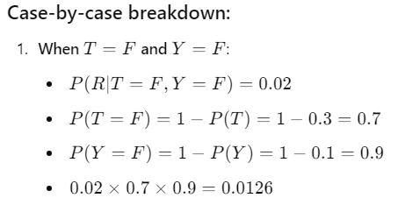
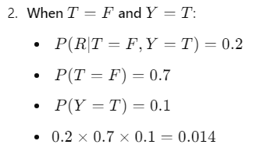

Slide 8
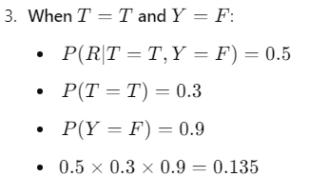
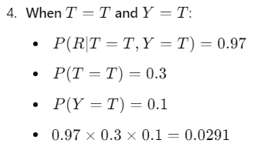
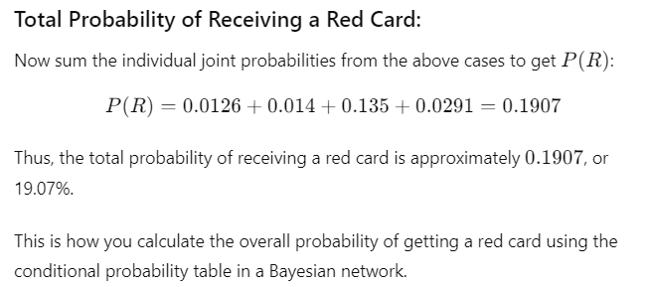

Slide 9

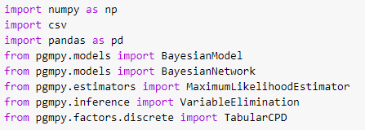
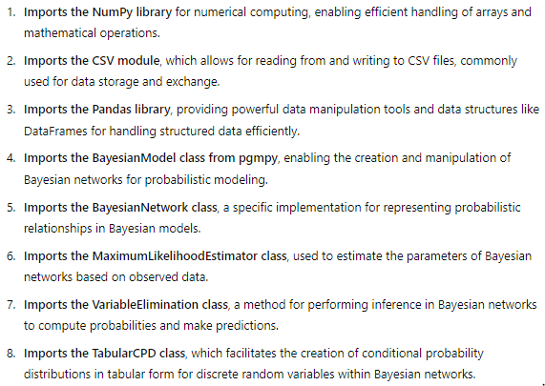
Now, coming to practical:-

Slide 10
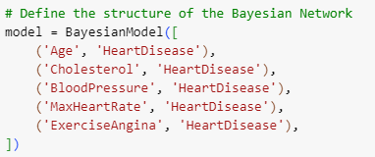
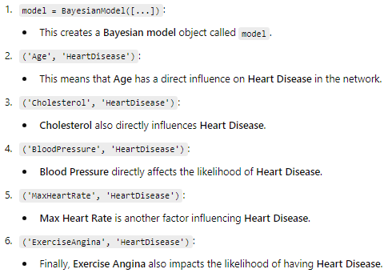

Slide 11
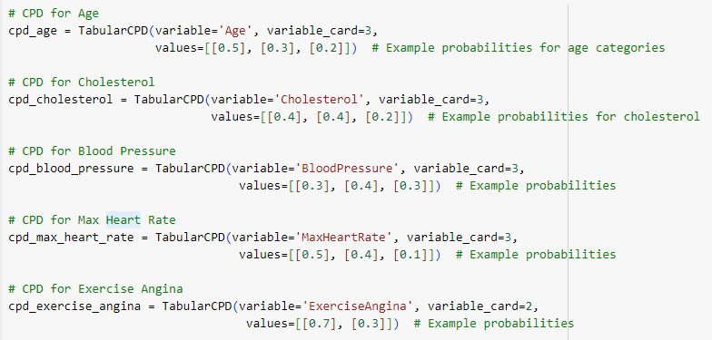
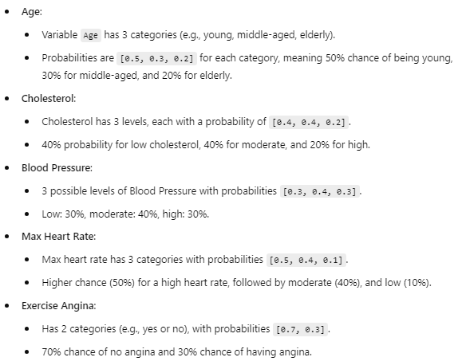
This code snippet defines Conditional Probability Distributions (CPDs) for the variables in the Bayesian Network related to heart disease risk factors. Each CPD assigns probabilities to different categories of a variable.

Slide 12
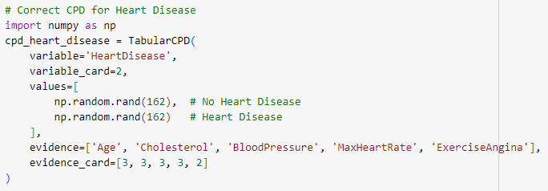
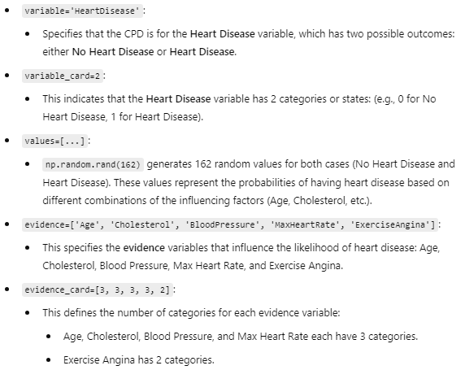
This code defines a Conditional Probability Distribution (CPD) for the HeartDisease variable in a Bayesian Network, with probabilities conditioned on multiple factors.

Slide 13

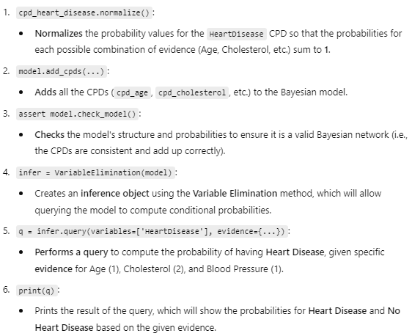

Slide 14
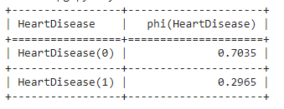


Slide 15
Implement the non-parametric locally weighted regression algorithm in order to fit data points. Select appropriate dataset for your experiment and draw graph.
ML Practical – 8 B

Slide 16


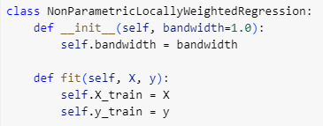



Slide 17

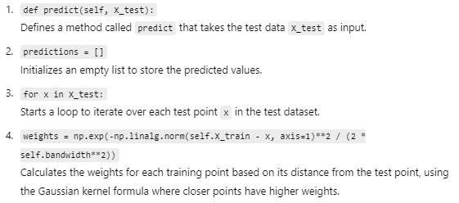

Slide 18
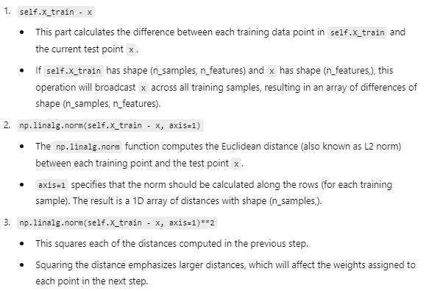
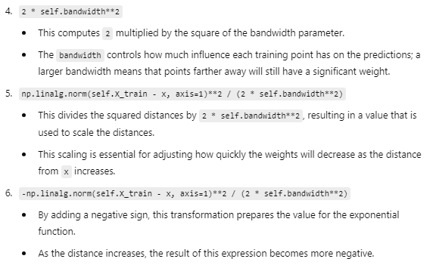


Slide 19

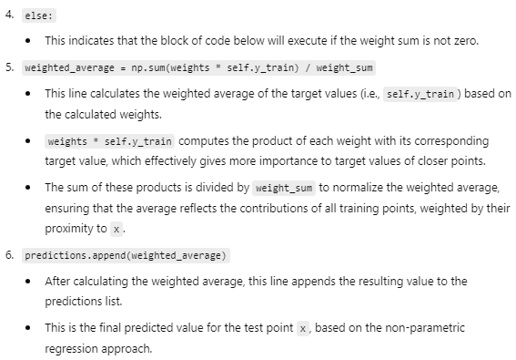
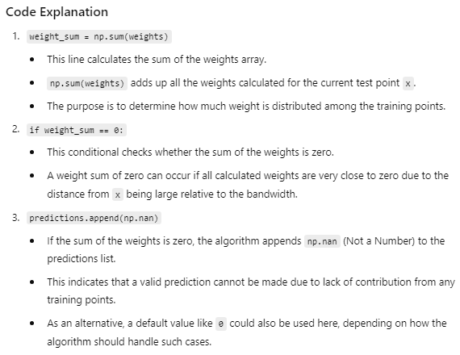


Slide 20
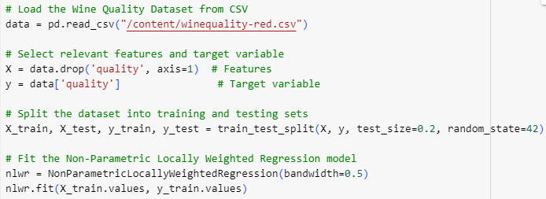
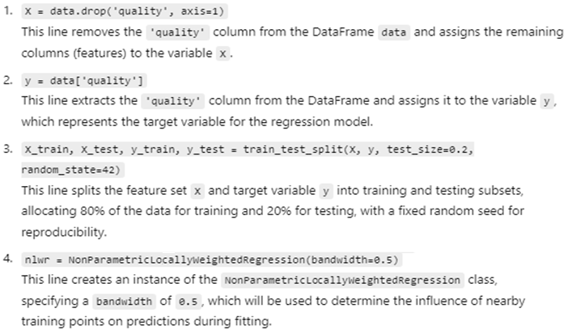

Slide 21
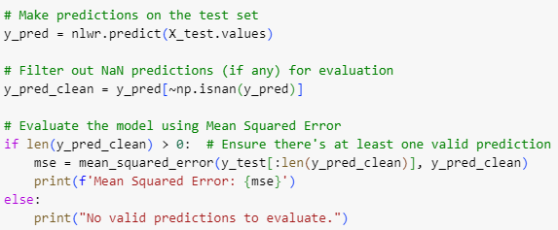
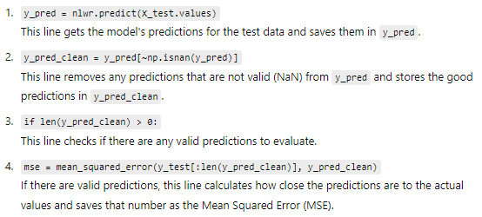

Slide 22

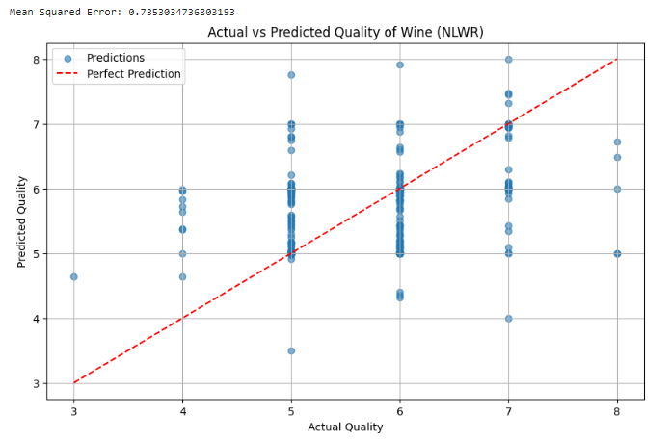
This code creates a scatter plot to compare the actual wine quality values against the predicted values from the Non-Parametric Locally Weighted Regression model. It includes a diagonal red dashed line representing perfect predictions, helping to visualize how closely the predictions match the actual values.

